Slide 1

An AX 2012 Upgrade Journey

Slide 2
Description
In this session, we’ll walk through the process of upgrading to the latest version of Finance and Operations including code upgrade, data upgrade, new features, features that are going away, how to upgrade, what "pre-work" to expect and what life will be like in the cloud.
PowerPoint available for download at https://github.com/NathanClouseAX/CommunityPresentations/tree/master/2021

Slide 3

Free Stuff
Gift Card Give Away!

Slide 4

Nathan Clouse
Technical Architect enVista Corp.
Microsoft Business Applications MVP (2x)
nclouse@envistacorp.com
www.atomicax.com
@NathanClouseAX

Slide 5
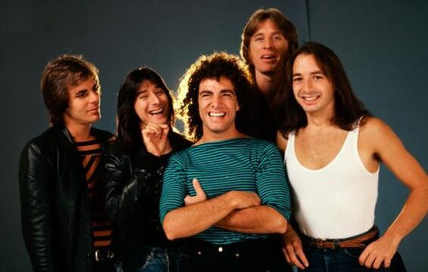
What we’ll cover today
AX 2009
Technical
Functional
AX 2012 R2/R3
Technical
Functional
Homework
Cleanup

Slide 6

Upgrades – Why do I need this?
Your system is nearing the end of Microsoft support!
AX 2009
AX 2012
Mainstream support ended October 9, 2018
Extended support ends – April 12, 2022
AX 2012 RTM & R2 – Mainstream support ended Oct 9, 2018
AX 2012 RTM & R2 – Extended support ends April 12, 2022
AX 2012 R3 – Mainstream support ends October 12, 2021 (YESTERDAY)
AX 2012 R3 – Extended support ends January 10, 2023
End of mainstream support for Microsoft Dynamics AX 2009, Dynamics AX 2012, and Dynamics AX 2012 R2 - Finance & Operations | Dynamics 365 | Microsoft Docs

Slide 7
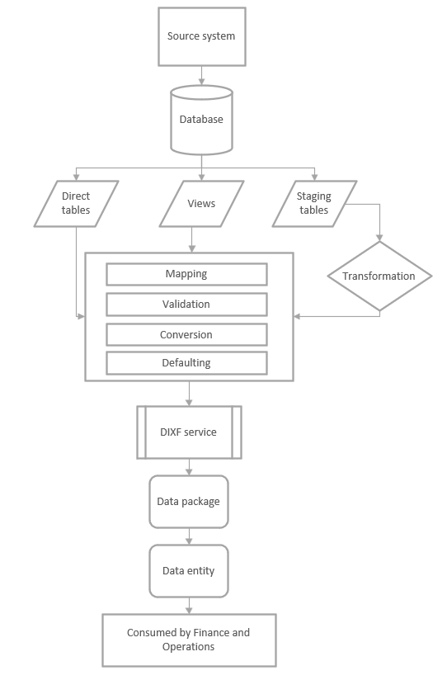
AX 2009 - Technical
Migrate Master Data
Transactions not included
Must install Data Migration Tool (DMT)
Installs DIXF for AX 2009
Currently in private preview
Have to ask MSFT for this
Links
https://dynamics.microsoft.com/en-us/migration-program/
https://microsoft.qualtrics.com/jfe/form/SV_brOLCioQ7mmeykB

Slide 10
AX 2009 - Technical
Migrate Master Data
Transactions not included
Must install Data Migration Tool (DMT)
Installs DIXF for AX 2009
Currently in private preview
Have to ask MSFT for this
Links
https://dynamics.microsoft.com/en-us/migration-program/
https://microsoft.qualtrics.com/jfe/form/SV_brOLCioQ7mmeykB

Slide 11
AX 2009 - Prerequisites
Microsoft SQL Server 2008/2012/2014/2016.
The Microsoft .NET Framework version 4.5 or later.
Microsoft SQL Server machine that has Microsoft SQL 2012 Native Client installed.
The Microsoft SQL Server Integration Services (SSIS) service is installed and running on the machine where the DMT service will be installed.
SQL Server authentication must support both SQL authentication and Microsoft Windows authentication.

Slide 12

AX 2009 – Prerequisites Part 2
Microsoft Access database engine
32-bit and 64-bit versions
Microsoft Dynamics AX 2009 SP1 5.0.1000.52 or later.
A positive attitude

Slide 13

AX 2009 Functional
Run Cleanup tools
Nice to have
Just removed clutter
Run Database Consistency Check
Can find issues you need to address before moving data into data warehouse
Work with business for rules on what data will be migrated
Review new features and also completeness of offered features in 2009

Slide 14
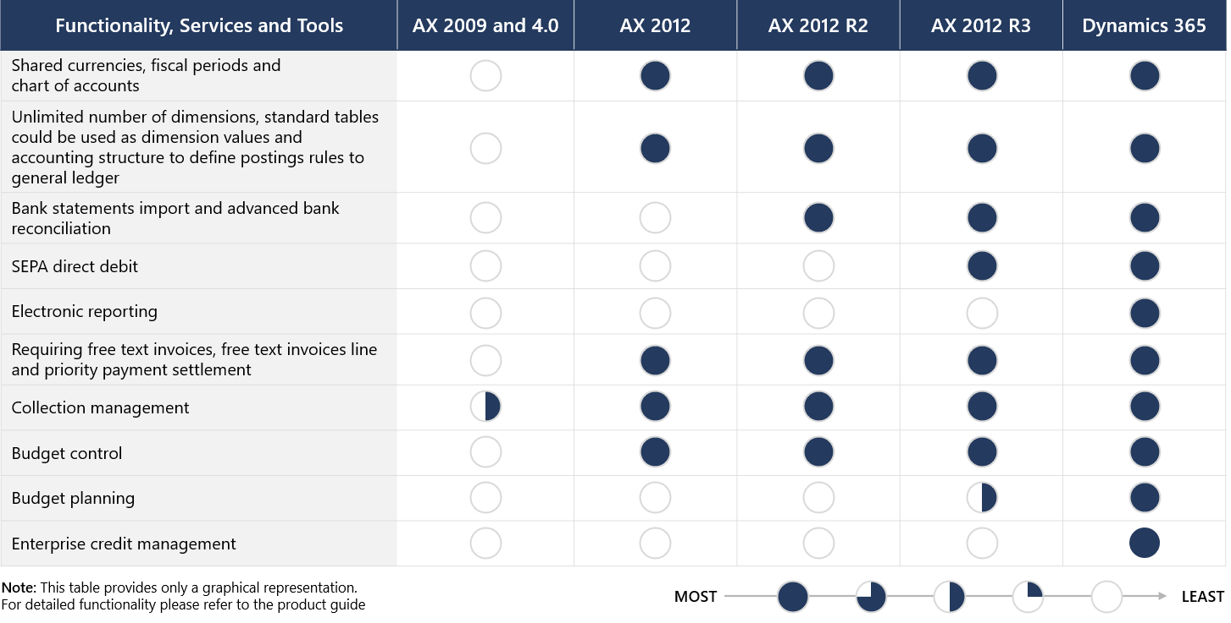
Financials

Slide 15
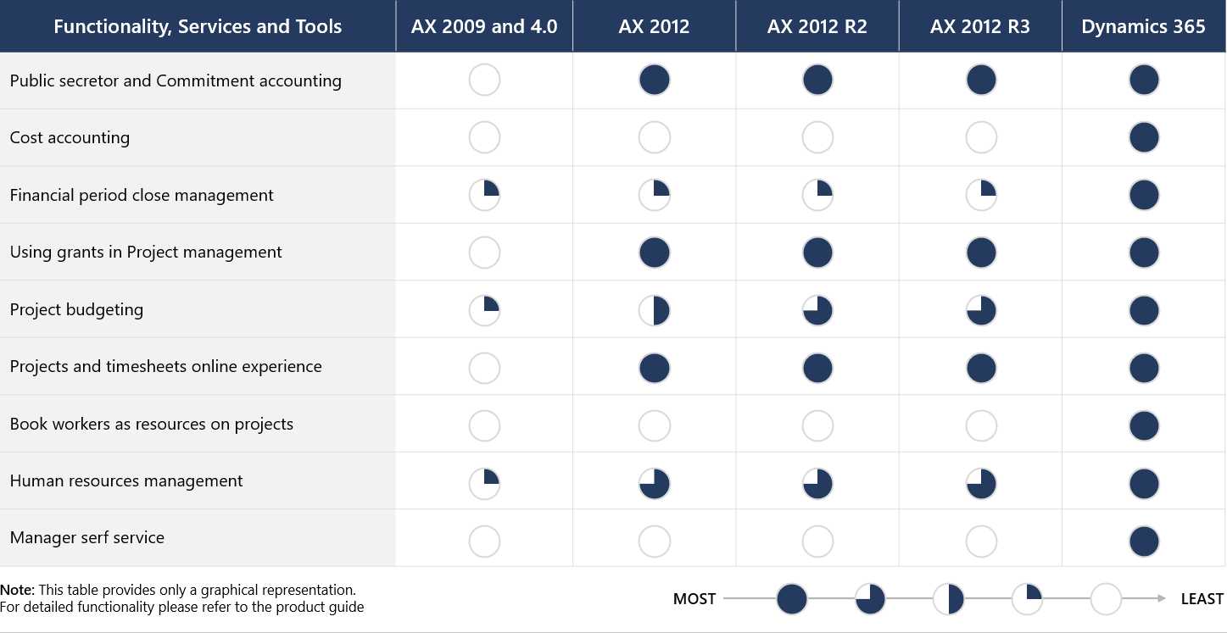
Financials – Industry Specific

Slide 16
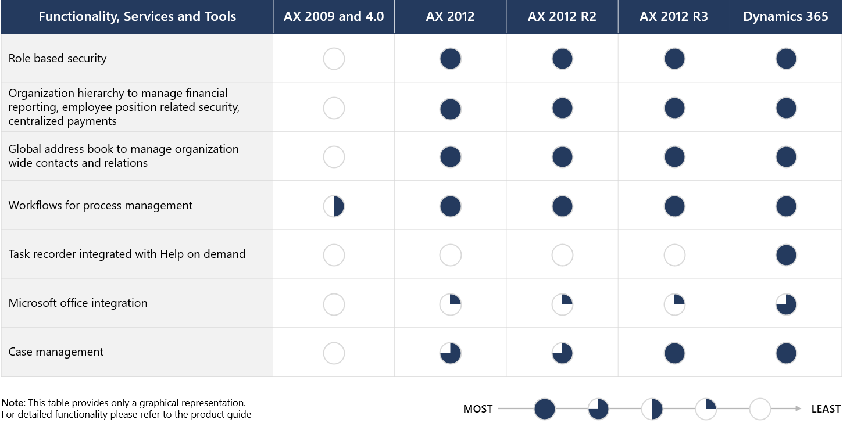
Organization-wide

Slide 17
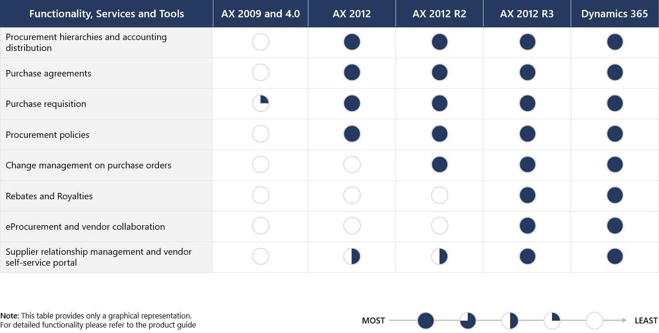
Procurement

Slide 18
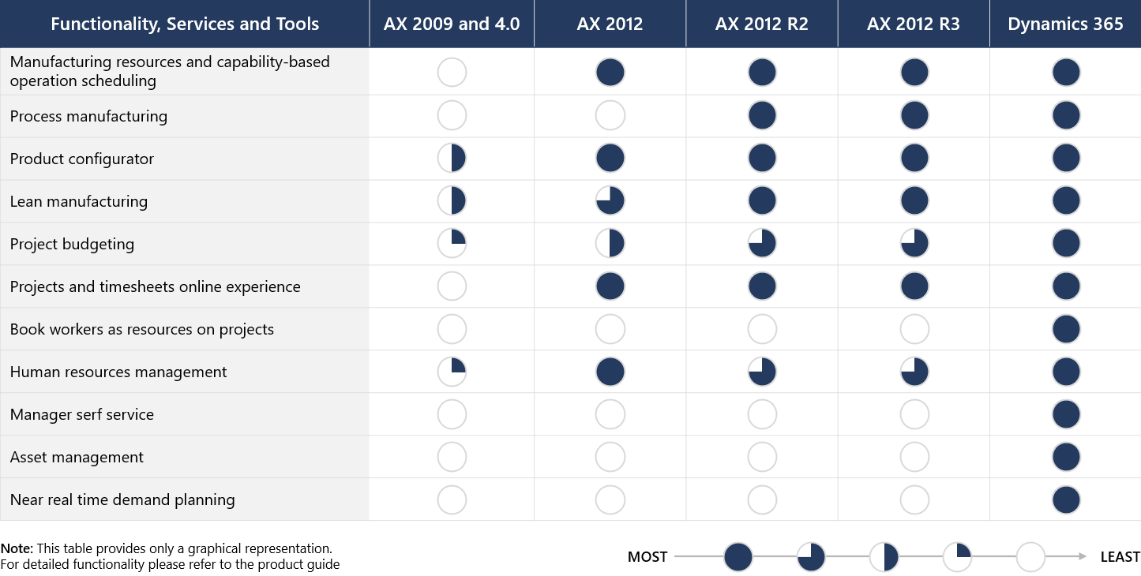
Manufacturing

Slide 19
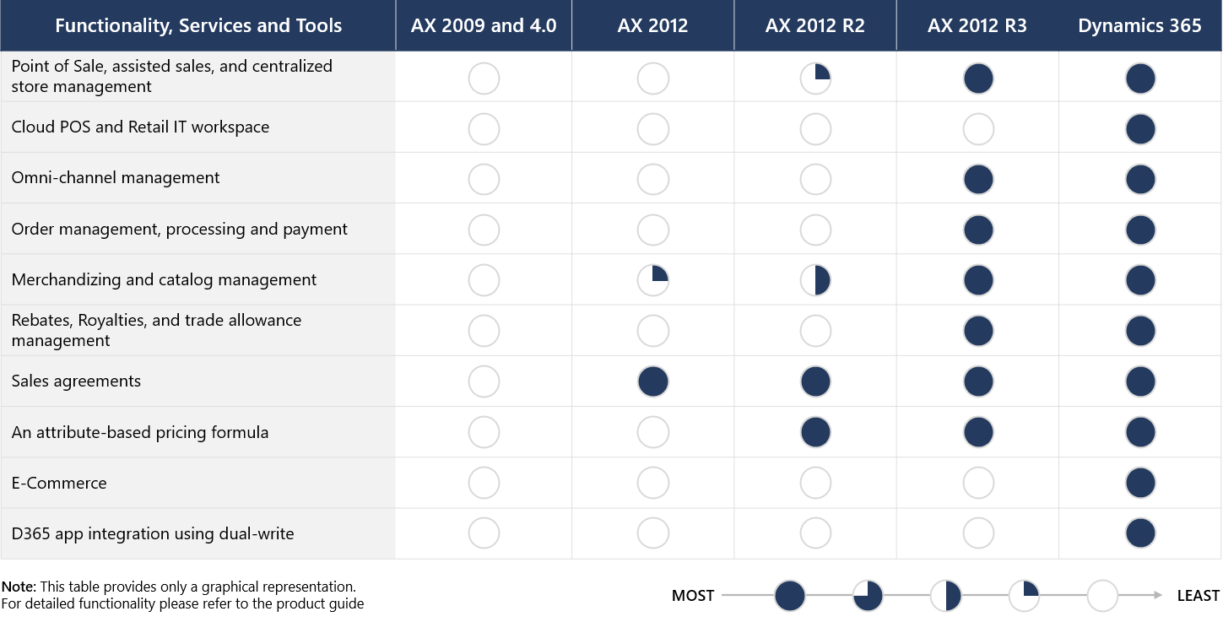
Sales Management and Retail/Commerce

Slide 20
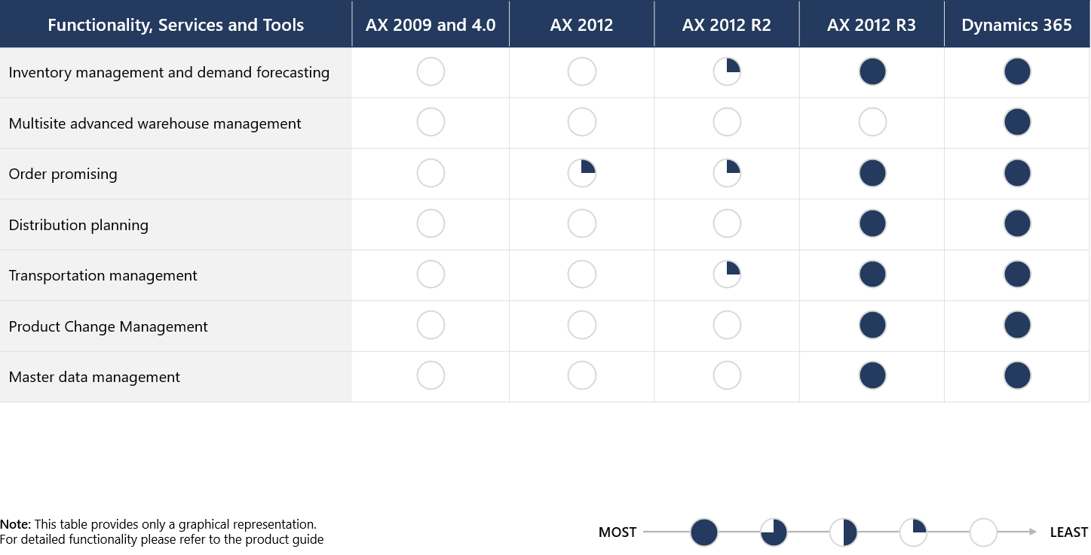
warehouse management and transportation

Slide 21
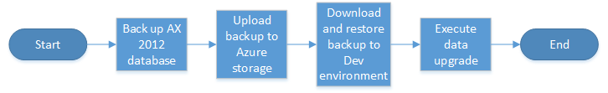
AX 2012 – Technical, Data
R2
Install KB 4035163
R3
Install KB 4048614
Run Checklist
Copy database to F&O Environment
Execute data upgrade
Notes:
https://docs.microsoft.com/en-us/dynamics365/fin-ops-core/dev-itpro/migration-upgrade/prepare-data-upgrade

Slide 22
Notes:
https://docs.microsoft.com/en-us/dynamics365/fin-ops-core/dev-itpro/migration-upgrade/prepare-data-upgrade

Slide 23
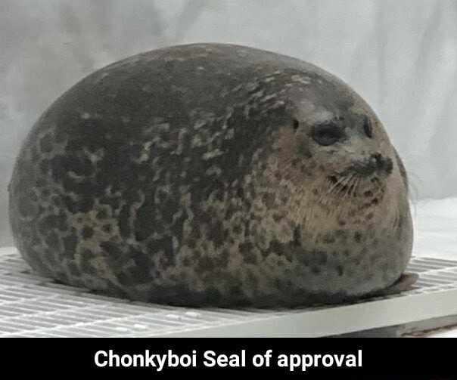
Shameless Plug
Want more info on data upgrades from AX 2012?
Attend Dynamics 365 F&O Upgrade Tech Talk: Data (AX 2012 Upgrade Series: Part 4)

Slide 24
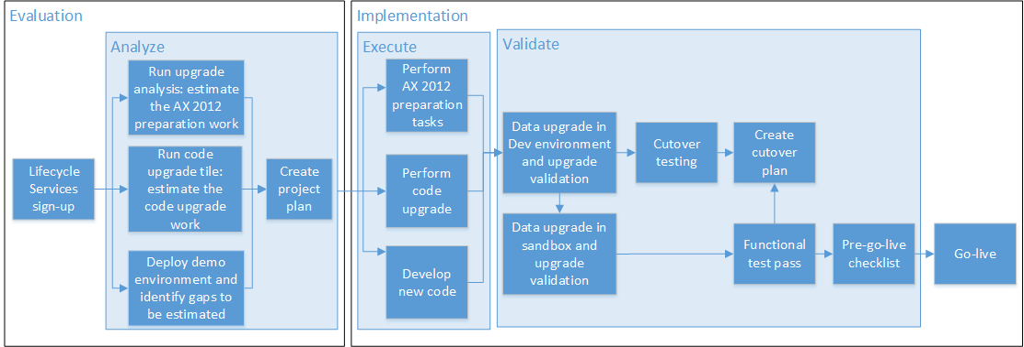
AX 2012 – Technical, Code
Upgrade Code in LCS
Life Cycle Services
Orchestrator for all F&O related activity
Notes:
https://docs.microsoft.com/en-us/dynamics365/fin-ops-core/dev-itpro/migration-upgrade/prepare-data-upgrade

Slide 25
Notes:
https://docs.microsoft.com/en-us/dynamics365/fin-ops-core/dev-itpro/migration-upgrade/prepare-data-upgrade

Slide 26
Notes:
https://docs.microsoft.com/en-us/dynamics365/fin-ops-core/dev-itpro/migration-upgrade/prepare-data-upgrade

Slide 27
Notes:
https://docs.microsoft.com/en-us/dynamics365/fin-ops-core/dev-itpro/migration-upgrade/prepare-data-upgrade
Standard migration analysis

Slide 28
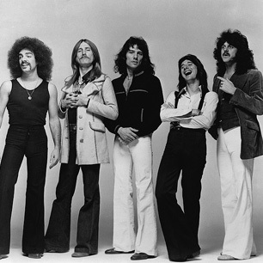
AX 2012 Functional
Run Cleanups
Run Database maintenance
Map out business processes
Create workflows for processes
Think about where you want to end with a fully implemented system and work backwards in your head

Slide 29

Database Upgrade Options
Methodologies
SQL Replication
DACPAC*
BACPAC*
Process
AX 2012 PROD to F&O UAT to F&O PROD
AX 2012 PROD to AX 2012 TEST to F&O UAT to F&O PROD
AX 2012 PROD to AX 2012 TEST to F&O Data upgrade VM to F&O UAT to F&O PROD
Environments
LCS Hosted
Azure Hosted
On Prem*

Slide 30
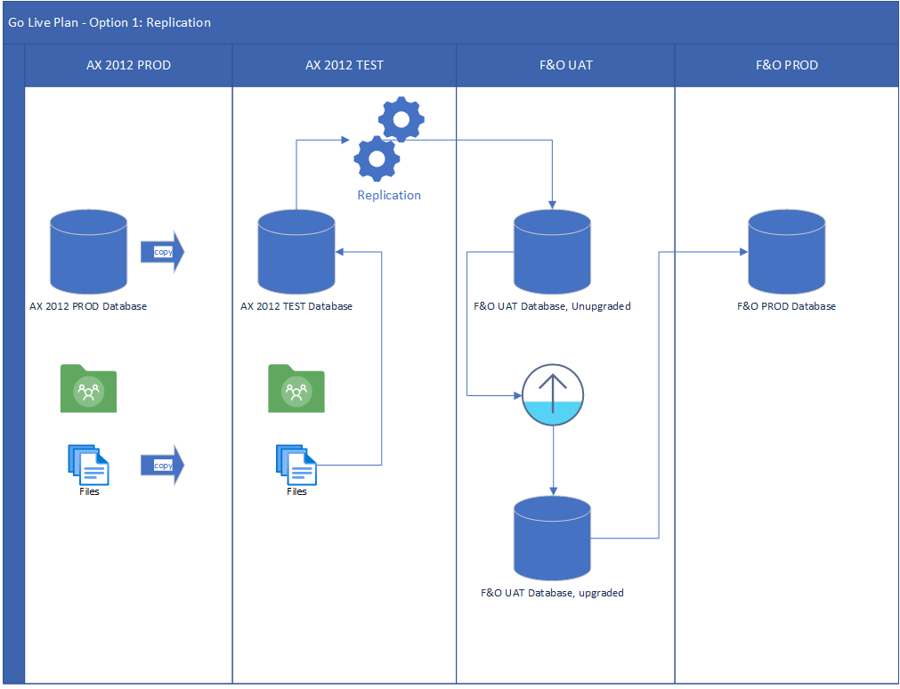

Slide 32
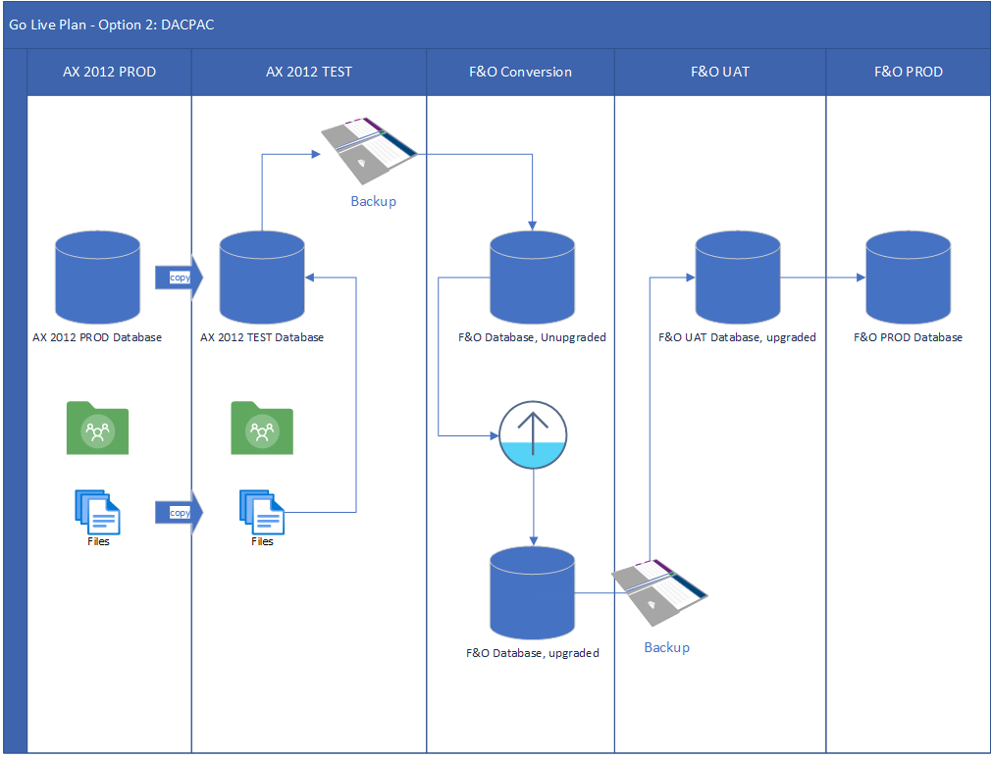

Slide 33
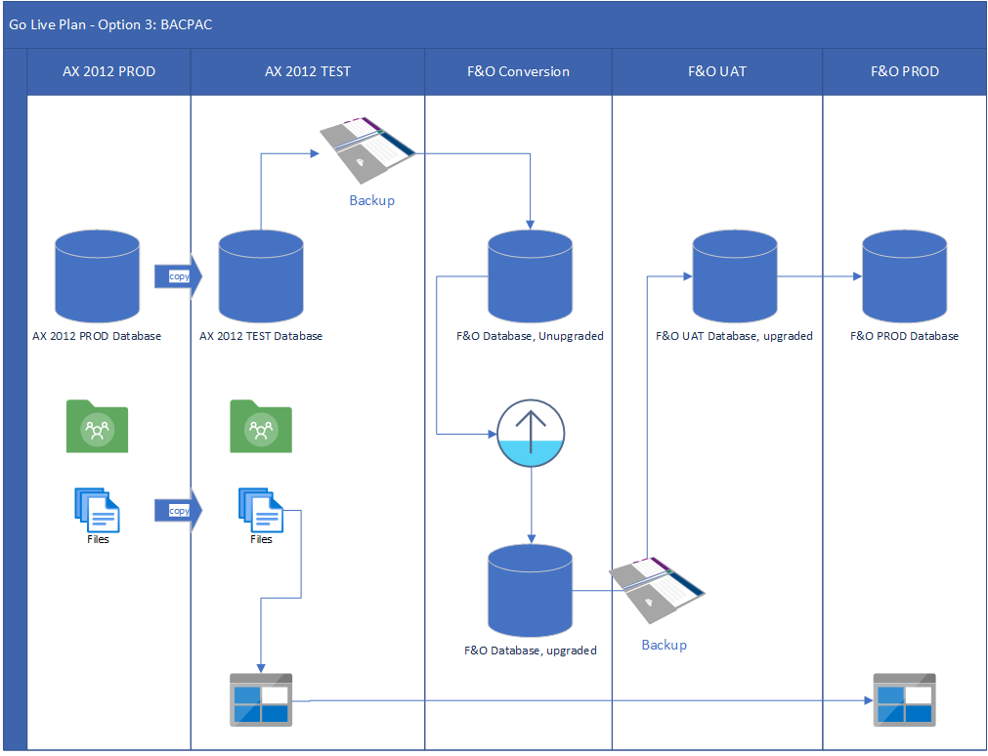

Slide 34
Styles of Upgrades
Implementation - Import master data into F&O from AX 2009, 2012, any other system
Upgrade
Technical – like for like, “lift and shift”
Upgrade all data
Address technical difficulties
Don’t change processes other than as required
Very little new functionality used
Cheapest option

Slide 35
Styles of Upgrades
Upgrade
Upgrade Re-implementation
Upgrade all data
Re-evaluating customizations to see if they are needed
Change process to take advantage of system or tech changes
New functionality used whenever possible or appropriate
Not the cheapest option

Slide 36
Technical Upgrade
Cheapest
Implementation
Very similar to implementing any new system
Upgrade Re-Implementation
Potentially the most expensive
Fastest
Least Amount
Least Amount of value
Concepts will be familiar but have to review all business process for future state
Potentially the longest timeline
Maximizes usage of OOTB functionality

Slide 37
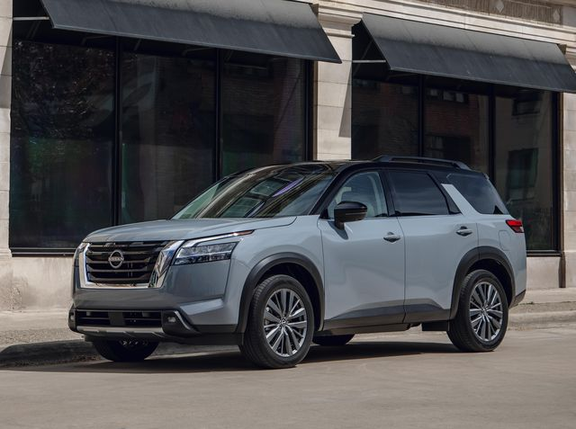
ERP Is Cheap
For around 40k a year, give or take, you can get F&O.
Everything around ERP gets expensive
Integrations and Interfaces

Slide 38
Example 1: Airport
Upgrading from AX 2012 R2
Database upgrade
Code Upgraded
Re-evaluated customizations
Re-evaluation of interfaces
Went live after desired go-live date
Went live using only 38% of budget

Slide 39
Example 2: Consume Goods Manufacturer (Omnichannel)
Upgrading from AX 2012 R3 CU11
Code and Data upgraded
ISVs removed / replaced
All code reviewed, most kept
Interfaces / integrations all re-evaluated and reworked for the cloud
Still not live
Over Budget

Slide 40
Final Words
Have a 1, 3 and 5 year plan for what you want from the system
Address what you have to address now or in the upgrade
Plan everything else out as a “fast follow”; phase 2 or 3+.
Be open to new processes and technologies
Focus on strategic differentiators

Slide 41


Slide 42
Questions?

Slide 43
Dynamics 365: Let’s talk Upgrade Rollout Approach (AX 2012 Upgrade Series: Part 6) – Tuesday @ 2:00
Dynamics 365 F&O Licensing, Upgrades, Costs and More (Part 2) – Tuesday @ 3:00
Retail and Warehousing: The Biggest Areas for Change in Dynamics 365 F&O (AX 2012 Upgrade Series: Part 3) – Wednesday @ 9:30
AX Sucks. Let’s talk Upgrades (AX 2012 Upgrade Series: Part 1)– Wednesday @ 10:30
An AX2012 Upgrade Journey - Wednesday @ 11:30
Dynamics 365 F&O Business Events From End to Start to End – Wednesday @ 1:40
Dynamics 365 F&O Upgrade Tech Talk: Code, Customizations, Extension and Power Platform (AX 2012 Upgrade Series: Part 5) – Thursday @ 10:00
How To Get The Most Out of Your Upgrade (AX 2012 Upgrade Series: Part 2) – Thursday @ 1:10

Slide 44
My Other Presentations
Dynamics 365 F&O Business Events From End to Start to End – Wednesday @ 1:40
Dynamics 365 F&O OData From Zero To Hero – Thursday @ 9:00
F&O Integration Roundup - Thursday @ 11:00
X++ Development Tips and Tricks plus D365FO.Tools! – Thursday @ 2:10

Slide 45
Give Away!

Slide 46

Please visit our booth
enVista booth #700
Meet with our experts
Learn about industry-leading practices
Get the most from your Microsoft investments
Register to win a YETI™ cooler
enVista
Booth
Hall C Entry

Slide 47

Survey Code

